Slide 1
Unit-3 chapter 6 Bayesian Learning
B. Tech III Year
CS 601 PC
ASHA
KMIT

Slide 2
UNIT3
CHAPTER 6-BAYESIAN LEARNING
CHAPTER 7-COMPUTATIONAL LEARNING THEORY
CHAPTER 8-INSTANCE BASED LEARNING

Slide 3
CONTENTS
INTRODUCTION
BAYES THEOREM
BAYES THEOREM AND CONCEPT LEARNING
MAXIMUM LIKELIHOOD AND LEAST SQUARED ERROR HYPOTHESES
MAXIMUM LIKELIHOOD HYPOTHESES FOR PREDICTING PROBABILITIES
MINIMUM DESCRIPTION LENGTH PRINCIPLE
BAYES OPTIMAL CLASSIFIER
GIBBS ALGORITHM
NAÏVE BAYES CLASSIFIER
EXAMPLE:CLASSIFY TEXT
BAYESIAN BELIEF NETWORKS
THE EM ALGORITHM

Slide 4
6.1 | Bayesian Learning - Introduction
Bayesian reasoning provides a probabilistic approach to inference. It is based on the assumption that the quantities of interest are governed by probability distributions and that optimal decisions can be made by reasoning about these probabilities together with observed data.
It is important to machine learning because it provides a quantitative approach to weighing the evidence supporting alternative hypotheses.
Bayesian reasoning provides the basis for learning algorithms that directly manipulate probabilities, as well as a framework for analyzing the operation of other algorithms that do not explicitly manipulate probabilities

Slide 5

6.2 | BAYES THEOREM
Bayes theorem is the cornerstone of Bayesian learning methods because it provides a way to calculate the posterior probability P(h|D), from the prior probability P(h), together with P(D) and P(D(h).
As one might intuitively expect, P(h ID) increases with P(h) and with P(D|h) according to Bayes theorem. It is also reasonable to see that P(h|D) decreases as P(D) increases, because the more probable it is that D will be observed independent
of h, the less evidence D provides in support of h.

Slide 6
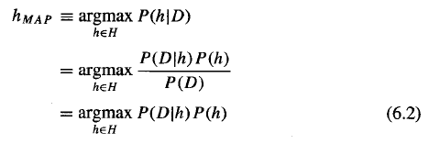
In many learning scenarios, the learner considers some set of candidate hypotheses H and is interested in finding the most probable hypothesis h ϵ H given the observed data D (or at least one of the maximally probable if there are several). Any such maximally probable hypothesis is called a maximum a posteriori (MAP) hypothesis. We can determine the MAP hypotheses by using
Bayes theorem to calculate the posterior probability of each candidate hypothesis.
More precisely, we will say that MAP is a MAP hypothesis provided

Slide 7
6.2.1 An Example
To illustrate Bayes rule, consider a medical diagnosis problem in which there are
two alternative hypotheses:
(1) that the patient has a particular form of cancer, and
(2) that the patient does not.
The available data is from a particular laboratory test with two possible outcomes:
We have prior knowledge that over the entire population of people only .008 have this disease.
Furthermore, the lab test is only an imperfect indicator of the disease. The test
returns a correct positive result in only 98% of the cases in which the disease is
actually present and a correct negative result in only 97% of the cases in which
the disease is not present. In other cases, the test returns the opposite result.

Slide 8


The above situation can be summarized by the following probabilities:
Suppose we now observe a new patient for whom the lab test returns a positive result. Should we diagnose the patient as having cancer or not? The maximum a posteriori hypothesis can be found using Equation (6.2):

Slide 9
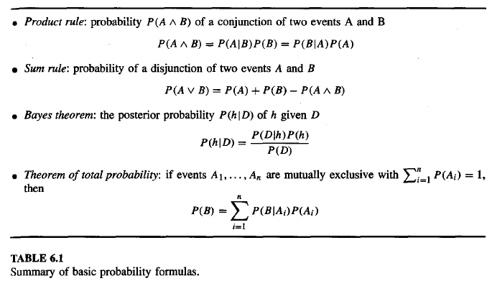
6.3 | BAYES THEOREM AND CONCEPT LEARNING
What is the relationship between Bayes theorem and the problem of concept learning?
Since Bayes theorem provides a principled way to calculate the posterior
probability of each hypothesis given the training data, we can use it as the basis
for a straightforward learning algorithm that calculates the probability for each
possible hypothesis, then outputs the most probable.

Slide 10
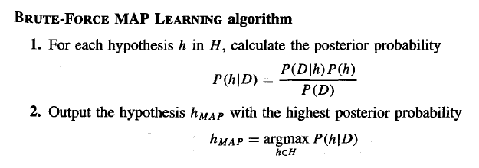
6.3.1 Brute-Force Bayes Concept Learning
In order specify a Iearning problem for the BRUTE-FORCE MAP LEARNING algorithm we must specify what values are to be used for P(h) and for P(D|h) (as we shall see, P(D) will be determined once we choose the other two). We may choose the probability distributions P(h) and P(D|h) in any way we wish, to describe our prior knowledge about the learning task. Here let us choose them
to be consistent with the following assumptions:

Slide 11
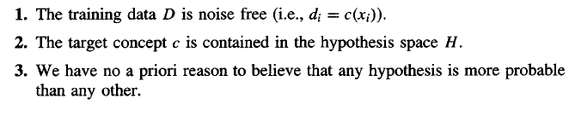
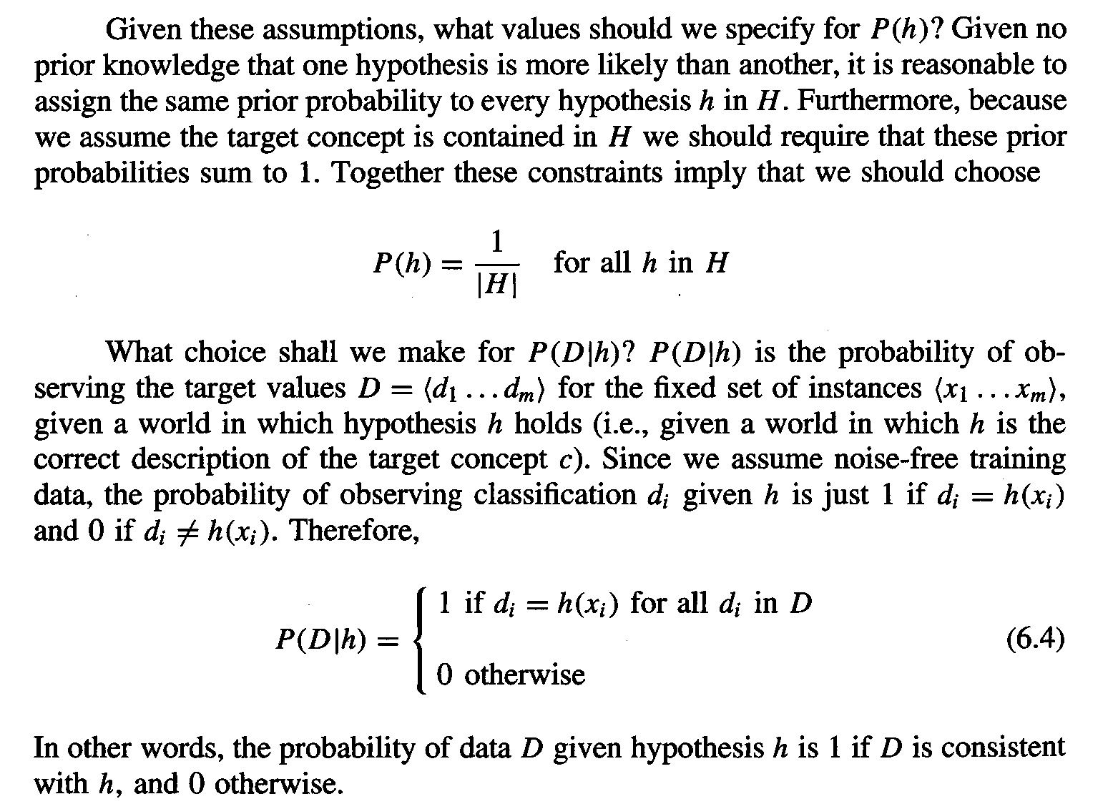

Slide 12
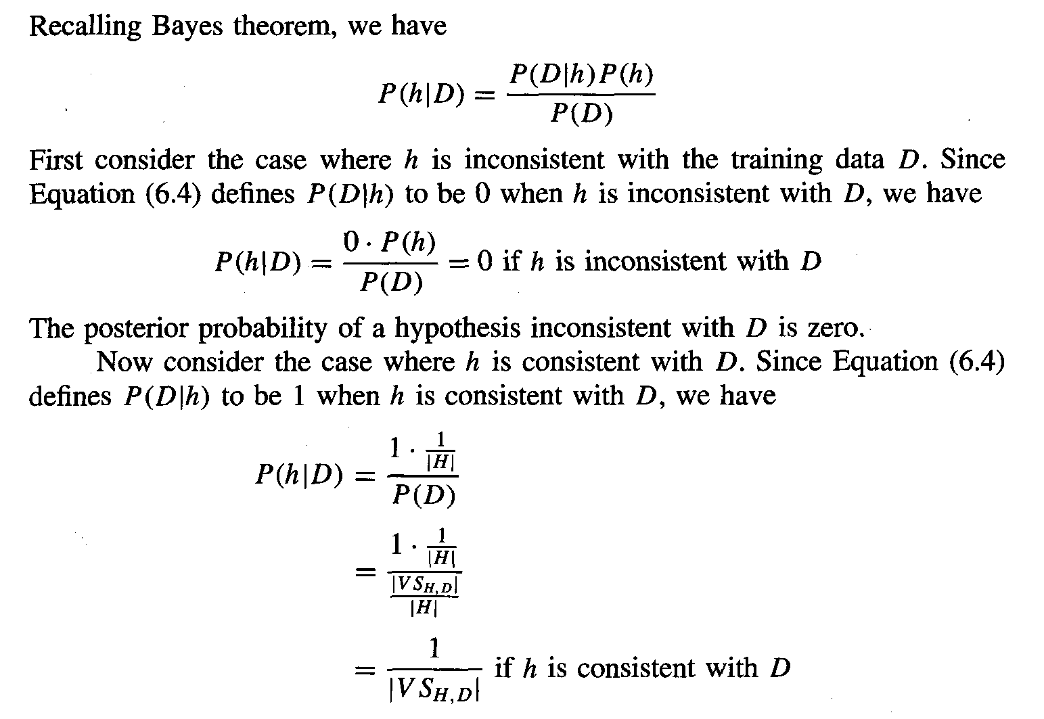

Slide 13
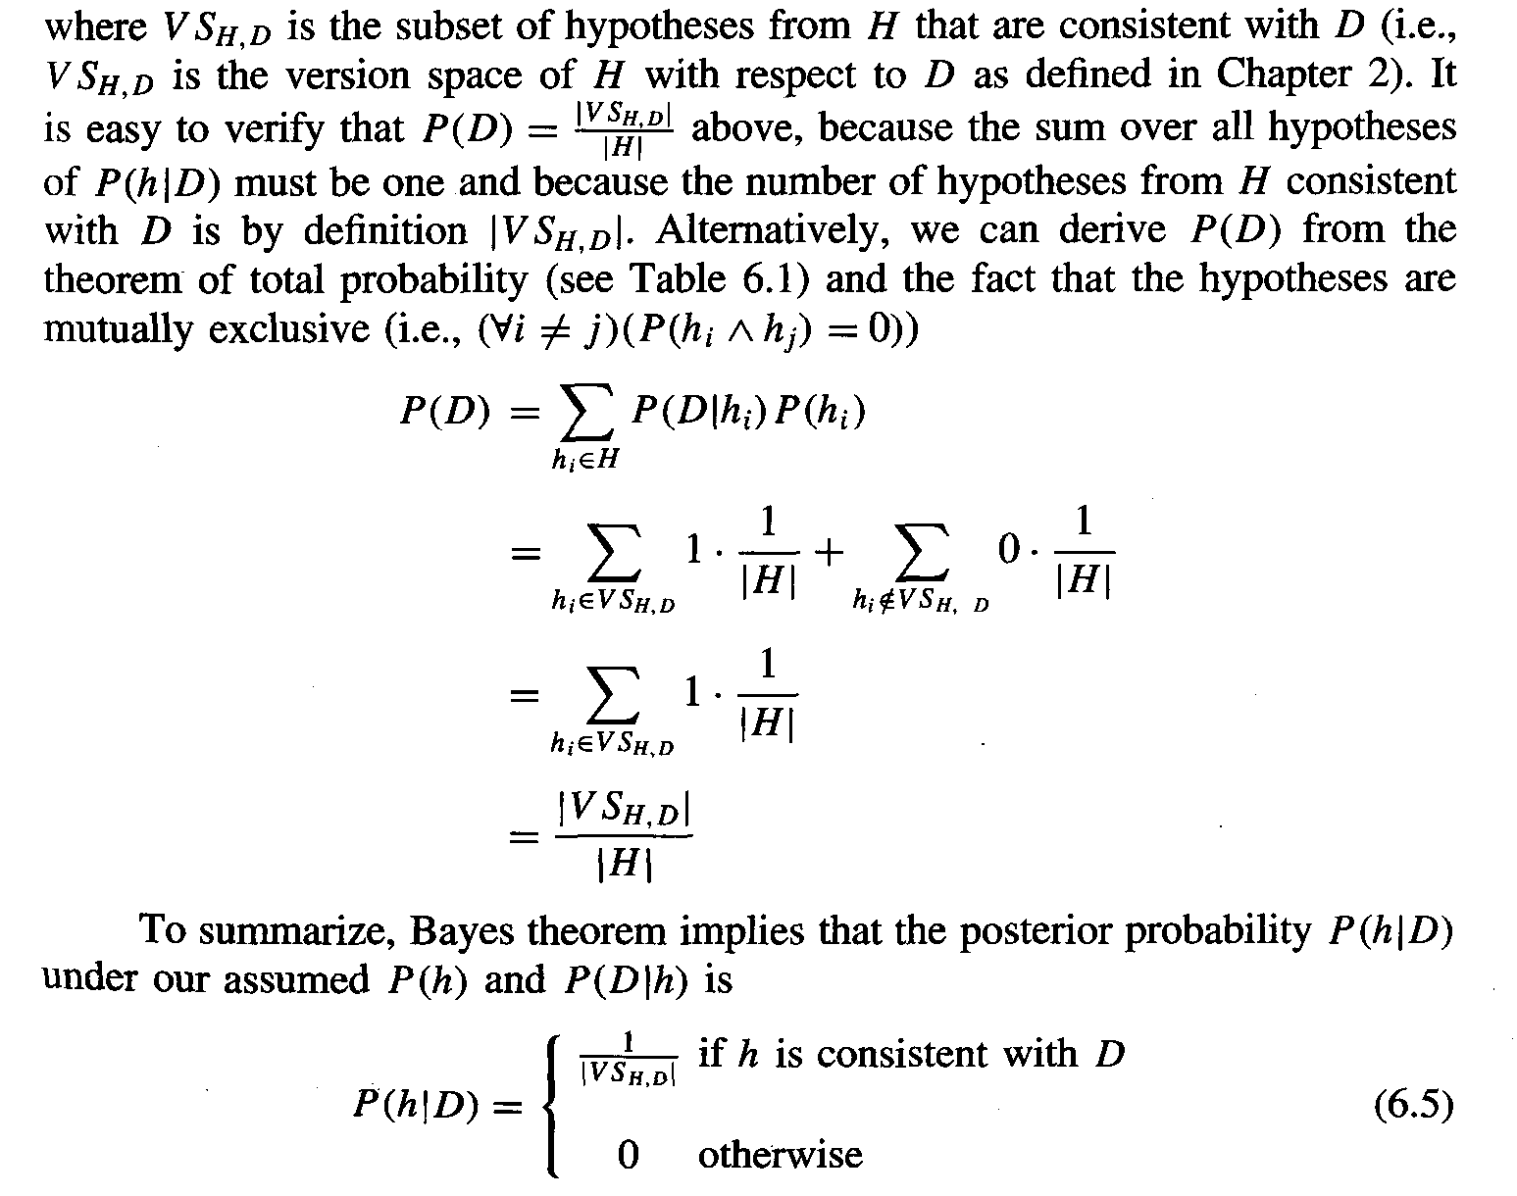

Slide 14
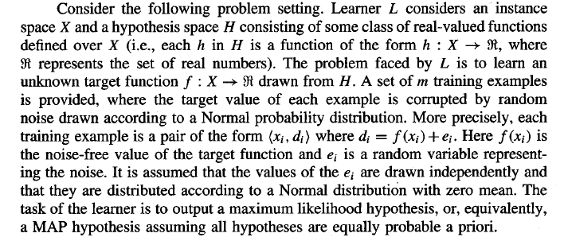
6.4 MAXIMUM LIKELIHOOD AND LEAST-SQUARED ERROR HYPOTHESES

Slide 15
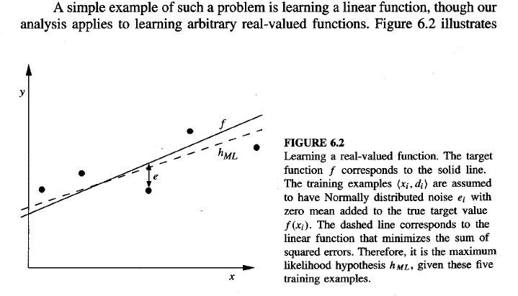

Slide 16
a linear target function f depicted by the solid line, and a set of noisy training examples of this target function. The dashed line corresponds to the hypothesis h_{ML} with least-squared training error, hence the maximum likelihood hypothesis.
Notice that the maximum likelihood hypothesis is not necessarily identical to the correct hypothesis, f, because it is inferred from only a limited sample of noisy training data.

Slide 17
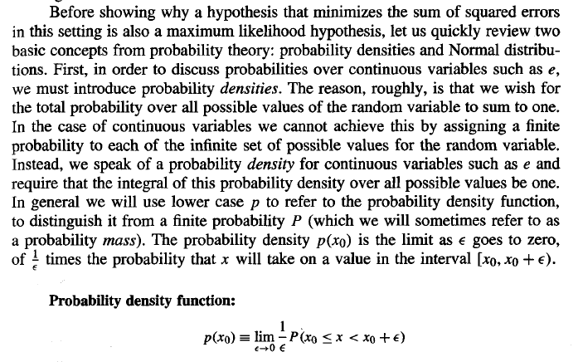

Slide 18
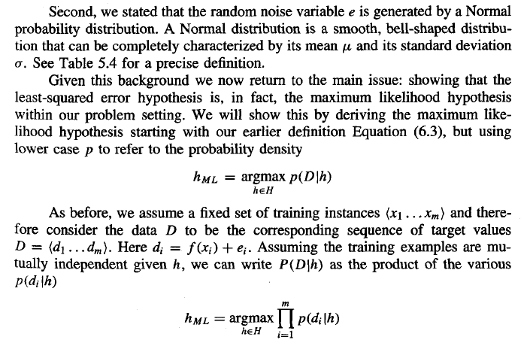

Slide 19
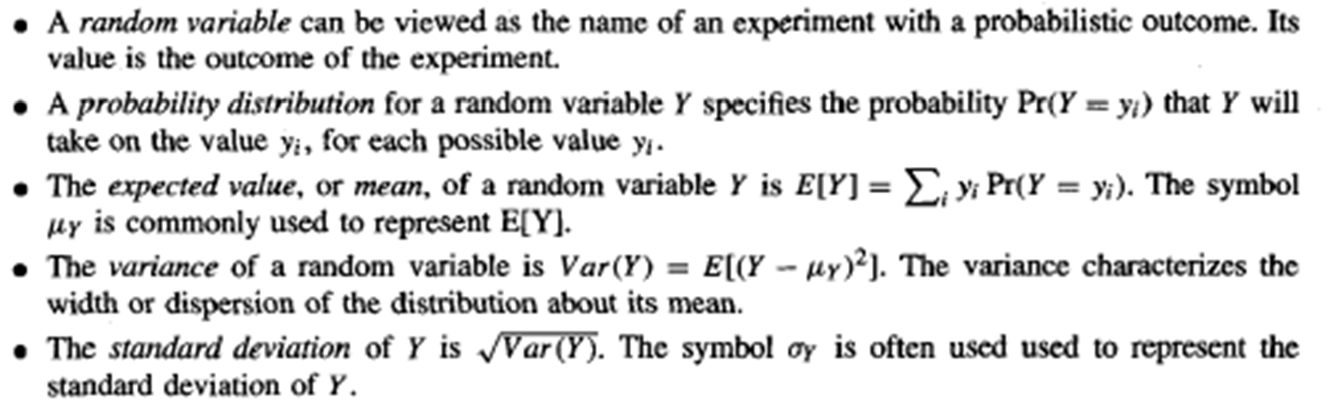
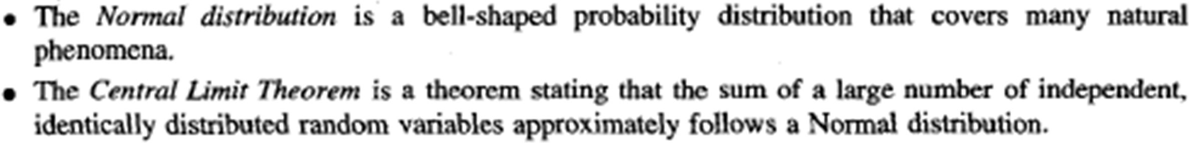
Basic Concepts from Probability Theory
Before showing why a hypothesis that minimizes the sum of squared errors in this setting is also a maximum likelihood hypothesis, let us quickly review basic concepts from probability theory

Slide 20
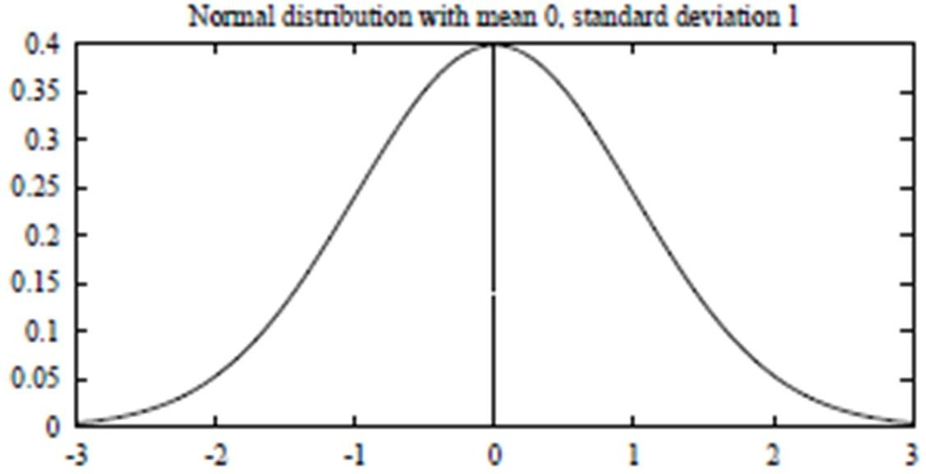
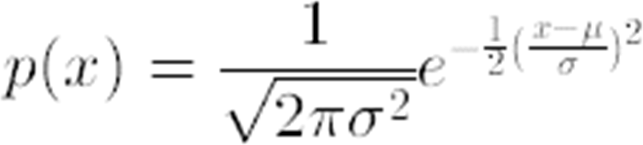
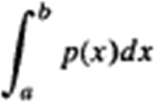
Basic Concepts from Probability Theory
A Normal Distribution (Gaussian Distribution) is a bell-shaped distribution defined by the probability density function
A Normal distribution is fully determined by two parameters in the formula:  and  .
If the random variable X follows a normal distribution:
The probability that X will fall into the interval (a, b) is
The expected, or mean value of X, E[X] = 
The variance of X, Var(X) = ²
The standard deviation of X, _{x} = 
The Central Limit Theorem states that the sum of a large number of independent, identically distributed random variables follows a distribution that is approximately Normal.

Slide 21
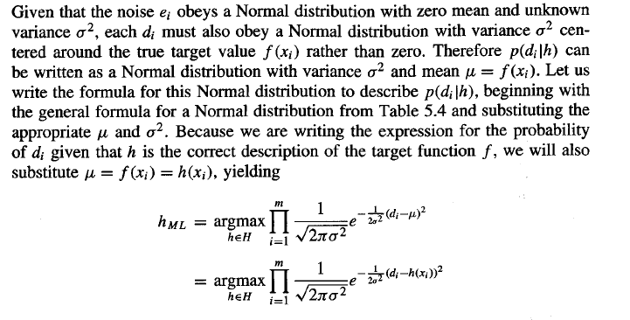

Slide 22
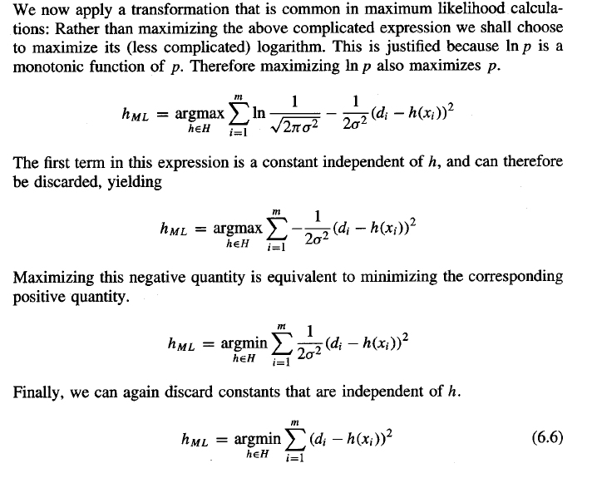

Slide 23
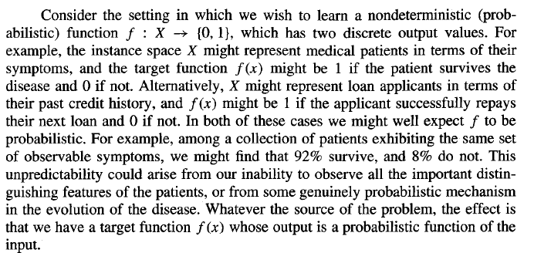
6.5 MAXIMUM LIKELIHOOD HYPOTHESES FOR PREDICTING PROBABILITIES

Slide 24
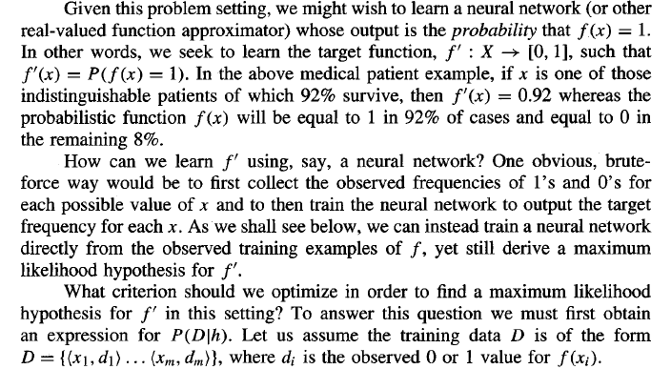

Slide 25
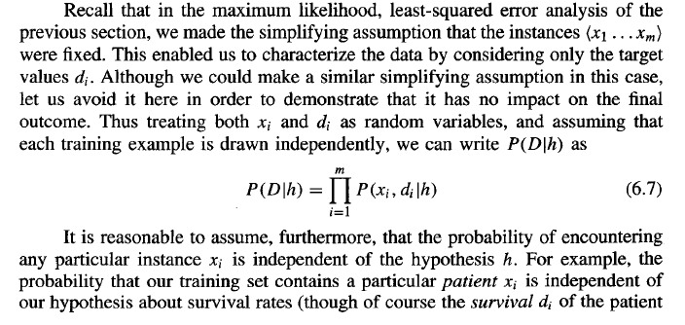

Slide 26
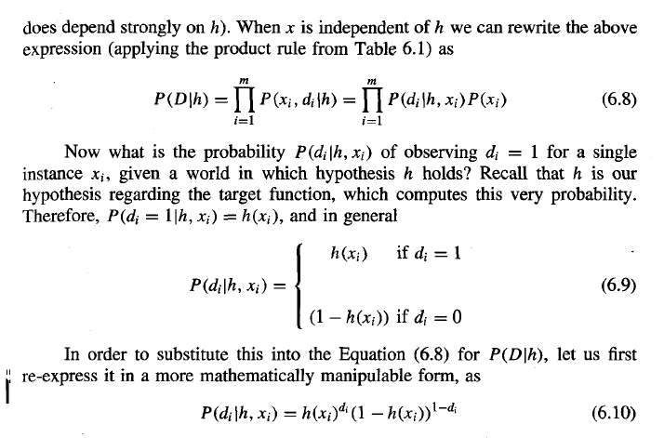

Slide 27
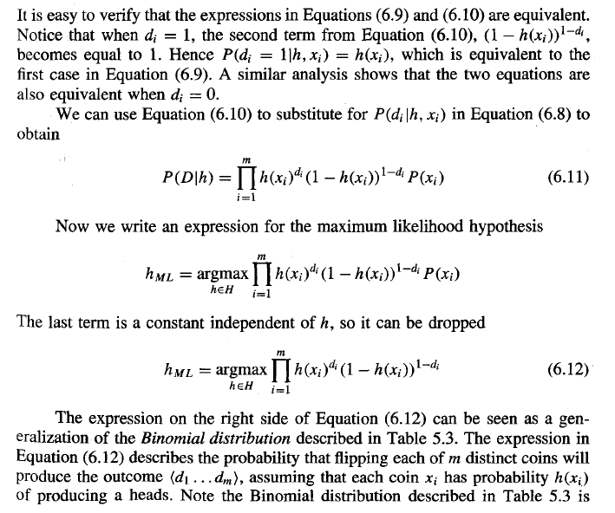

Slide 28
Maximum Likelihood and Least-Squared Error Hypotheses
The maximum likelihood hypothesis h_{ML} is the one that minimizes the sum of the squared errors between observed training values d_{i} and hypothesis predictions h(x_{i}).
This holds under the assumption that the observed training values d_{i} are generated by adding random noise to the true target value, where this random noise is drawn independently for each example from a Normal distribution with zero mean.
Similar derivations can be performed starting with other assumed noise distributions, producing different results.
Why is it reasonable to choose the Normal distribution to characterize noise?
One reason, is that it allows for a mathematically straightforward analysis.
A second reason is that the smooth, bell-shaped distribution is a good approximation to many types of noise in physical systems.
Minimizing the sum of squared errors is a common approach in many neural network, curve fitting, and other approaches to approximating real-valued functions.

Slide 29
MINIMUM DESCRIPTION LENGTH PRINCIPLE

Slide 30
Minimum Description Length Principle
Occam’s razor: prefer the simplest hypothesis
Simplest hypothesis → hypothesis with shortest description length
Minimum description length
Prefer shortest hypothesis
L_{C} (x) is the description length for message x under coding scheme c
# of bits to encode hypothesis h
# of bits to encode data D given h
Complexity of Model
# of Mistakes

Slide 31
Minimum Description Length Principle
Sender
Receiver
Send only D ?
Send only h ?
D
Send h + D/h ?

Slide 32
Bayes Optimal Classifier
Normally we consider:
What is the most probable hypothesis given the training data?
We can also consider:
what is the most probable classification of the new instance given the training data?
Consider a hypothesis space containing three hypotheses, hl, h2, and h3.
Suppose that the posterior probabilities of these hypotheses given the training data are .4, .3, and .3 respectively.
Thus, hl is the MAP hypothesis.
Suppose a new instance x is encountered, which is classified positive by hl, but negative by
h2 and h3.
Taking all hypotheses into account, the probability that x is positive is .4 (the probability associated with h1), and the probability that it is negative is therefore .6.
The most probable classification (negative) in this case is different from the classification generated by the MAP hypothesis.

Slide 33
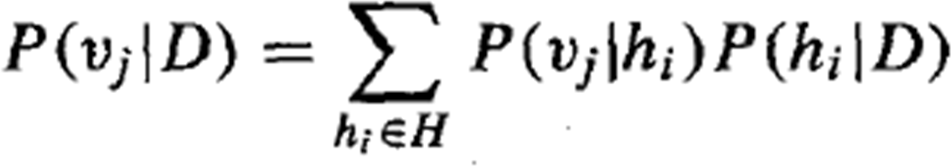
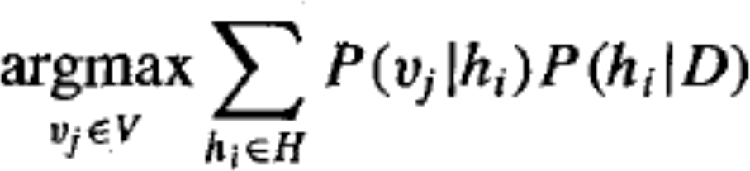
Bayes Optimal Classifier
The most probable classification of the new instance is obtained by combining the predictions of all hypotheses, weighted by their posterior probabilities.
If the possible classification of the new example can take on any value v_{j} from some set V, then the probability P(v_{j} | D) that the correct classification for the new instance is v_{j} :
Bayes optimal classification:

Slide 34
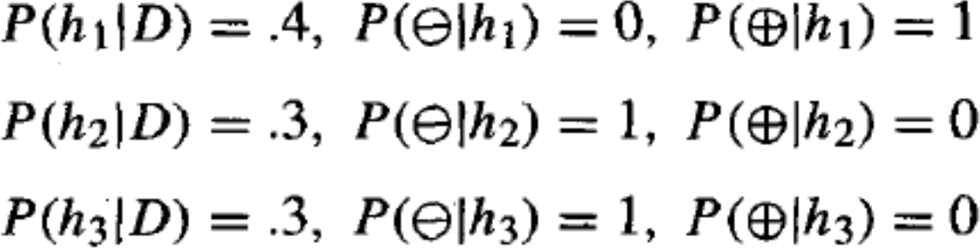
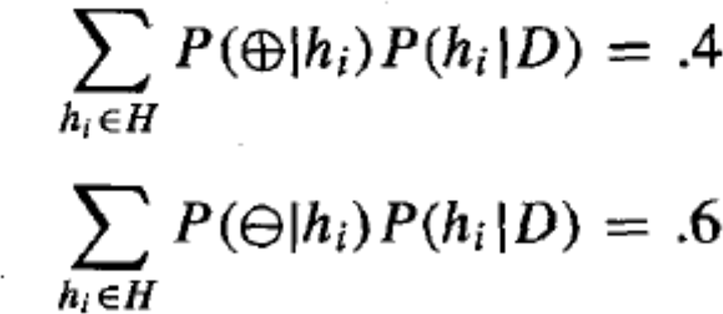
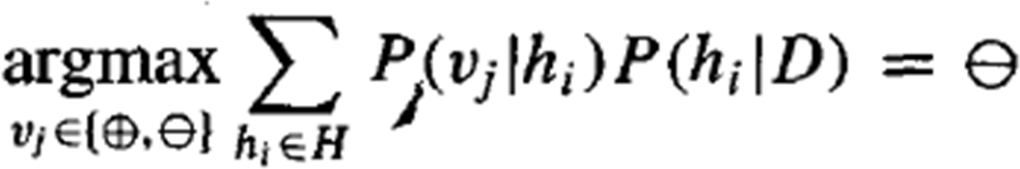
Bayes Optimal Classifier - Ex
Probabilities:
Result:

Slide 35
Bayes Optimal Classifier
Although the Bayes optimal classifier obtains the best performance that can be achieved from the given training data, it can be quite costly to apply.
– The expense is due to the fact that it computes the posterior probability for every hypothesis in H and then combines the predictions of each hypothesis to classify each new instance.
An alternative, less optimal method is the Gibbs algorithm:
Choose a hypothesis h from H at random, according to the posterior probability distribution over H.
Use h to predict the classification of the next instance x.

Slide 36
6.8 GIBBS ALGORITHM
Although the Bayes optimal classifier obtains the best performance that can be achieved from the given training data, it can be quite costly to apply. The expense is due to the fact that it computes the posterior probability for every hypothesis in H and then combines the predictions of each hypothesis to classify each new instance.
An alternative, less optimal method is the Gibbs algorithm , defined as follows:
Choose a hypothesis h from H at random, according to the
posterior probability distribution over H.
2. Use h to predict the classification of the next instance x.

Slide 37
Given a new instance to classify, the Gibbs algorithm simply applies a
hypothesis drawn at random according to the current posterior probability distribution. Surprisingly, it can be shown that under certain conditions the expected misclassification error for the Gibbs algorithm is at most twice the expected error of the Bayes optimal classifier . More precisely, the expected value is taken over target concepts drawn at random according to the prior probability distribution assumed by the learner. Under this condition, the expected value of the error of the Gibbs algorithm is at worst twice the expected value of the error of the Bayes optimal classifier.
This result has an interesting implication for the concept learning problem
described earlier. In particular, it implies that if the learner assumes a uniform prior over H, and if target concepts are in fact drawn from such a distribution when presented to the learner, then classifying the next instance according to a hypothesis drawn at random from the current version space (according to a uniform distribution), will have expected error at most twice that of the Bayes optimal classijier. Again, we have an example where a Bayesian analysis of a non-Bayesian algorithm yields insight into the performance of that algorithm.

Slide 38
6.9 NAIVE BAYES CLASSIFIER
One highly practical Bayesian learning method is the naive Bayes learner, often called the Naive Bayes classifier. In some domains its performance has been shown to be comparable to that of neural network and decision tree learning.
The naive Bayes classifier applies to learning tasks where each instance x is described by a conjunction of attribute values and where the target function f ( x ) can take on any value from some finite set V. A set of training examples of the target function is provided, and a new instance is presented, described by the
tuple of attribute values (a₁, a₂.. .a_{n}). The learner is asked to predict the target value, or classification, for this new instance.

Slide 39
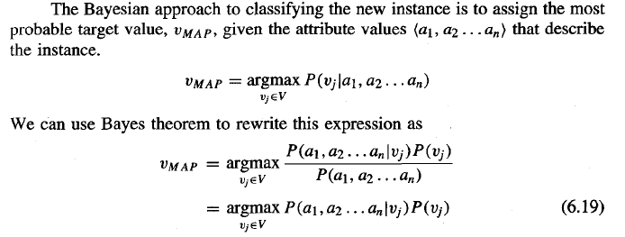
Now we could attempt to estimate the two terms in Equation (6.19) based on the training data. It is easy to estimate each of the P(v_{j}) simply by counting the frequency with which each target value vj occurs in the training data. However, estimating the different P(a₁, _{a2.}. . a_{n}) terms in this fashion is not feasible unless we have a very, very large set of training data. The problem is that the number of these terms is equal to the number of possible instances times the number of possible target values. Therefore, we need to see every instance in the instance space many times in order to obtain reliable estimates

Slide 40
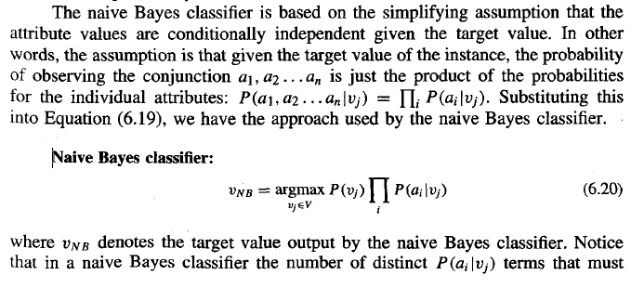

Slide 41
be estimated from the training data is just the number of distinct attribute values
times the number of distinct target values-a much smaller number than if we
were to estimate the P(a1, a2 . . . an lvj) terms as first contemplated.
To summarize, the naive Bayes learning method involves a learning step in
which the various P(vj) and P(ai Jvj) terms are estimated, based on their frequencies
over the training data. The set of these estimates corresponds to the learned
hypothesis. This hypothesis is then used to classify each new instance by applying
the rule in Equation (6.20). Whenever the naive Bayes assumption of conditional
independence is satisfied, this naive Bayes classification VNB is identical to the
MAP classification.
One interesting difference between the naive Bayes learning method and
other learning methods we have considered is that there is no explicit search
through the space of possible hypotheses (in this case, the space of possible
hypotheses is the space of possible values that can be assigned to the various P(vj)
and P(ailvj) terms). Instead, the hypothesis is formed without searching, simply by
counting the frequency of various data combinations within the training examples.

Slide 42
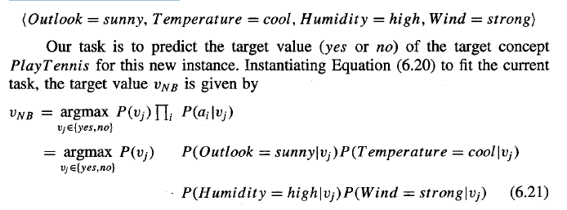
6.9.1 An Illustrative Example
Let us apply the naive Bayes classifier to a concept learning problem we considered
during our discussion of decision tree learning: classifying days according
to whether someone will play tennis. Table 3.2 from Chapter 3 provides a set
of 14 training examples of the target concept PlayTennis, where each day is
described by the attributes Outlook, Temperature, Humidity, and Wind. Here we
use the naive Bayes classifier and the training data from this table to classify the
following novel instance:

Slide 43
Naive Bayes Classifier - Ex
Day | Outlook | Temp. | Humidity | Wind | Play Tennis
D1 | Sunny | Hot | High | Weak | No
D2 | Sunny | Hot | High | Strong | No
D3 | Overcast | Hot | High | Weak | Yes
D4 | Rain | Mild | High | Weak | Yes
D5 | Rain | Cool | Normal | Weak | Yes
D6 | Rain | Cool | Normal | Strong | No
D7 | Overcast | Cool | Normal | Weak | Yes
D8 | Sunny | Mild | High | Weak | No
D9 | Sunny | Cold | Normal | Weak | Yes
D10 | Rain | Mild | Normal | Strong | Yes
D11 | Sunny | Mild | Normal | Strong | Yes
D12 | Overcast | Mild | High | Strong | Yes
D13 | Overcast | Hot | Normal | Weak | Yes
D14 | Rain | Mild | High | Strong | No
CS464 IntroMduaccthioi ne tLoeMarancinhgine Learning
33

Slide 44
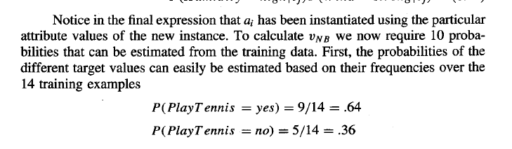
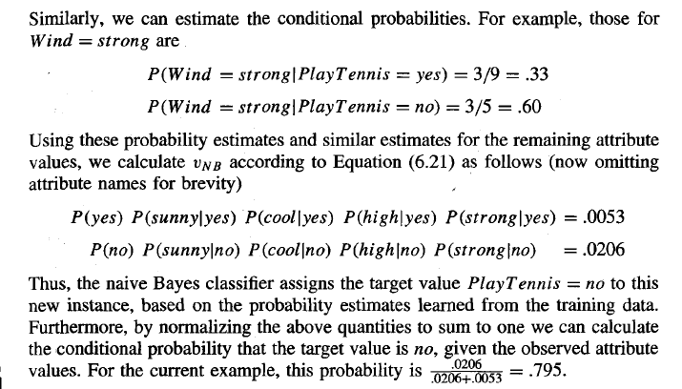

Slide 45
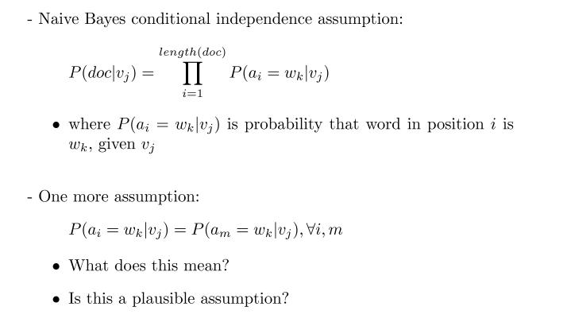
6.10 AN EXAMPLE: LEARNING TO CLASSIFY TEXT

Slide 46
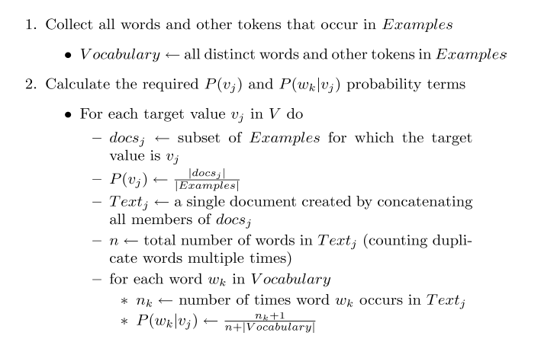

Slide 47
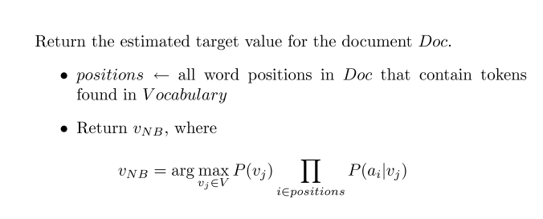

Slide 48
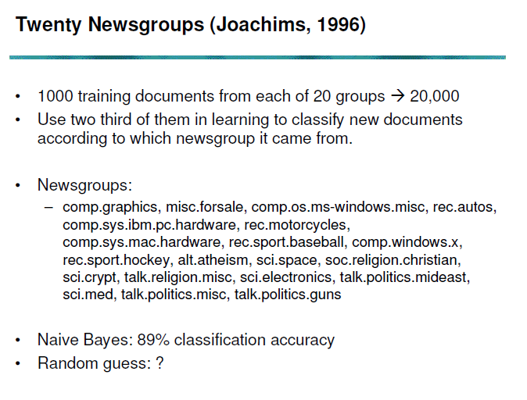

Slide 49
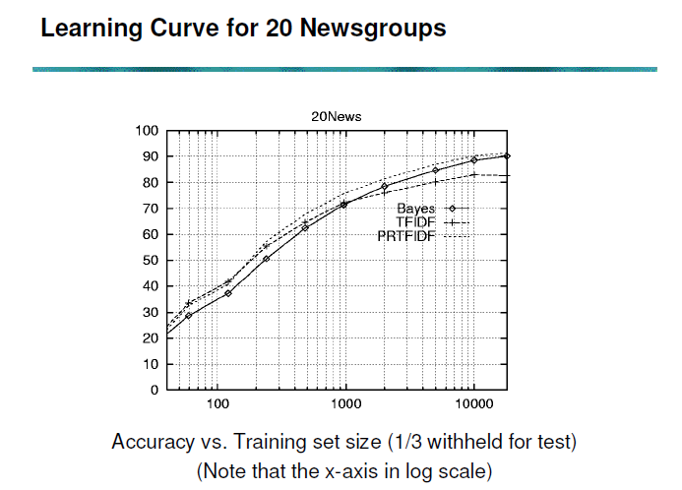

Slide 50
Bayesian Belief Networks
The Bayes Optimal Classifier is often too costly to apply.
The Naïve Bayes Classifier uses the conditional independence assumption to defray these costs. However, in many cases, such an assumption is overly restrictive.
Bayesian belief networks provide an intermediate approach which allows stating conditional independence assumptions that apply to subsets of the variable.

Slide 51
Conditional Independence
We say that X is conditionally independent of Y given Z if the probability distribution governing X is independent of the value of Y given a value for Z.
i.e., (∀x_{i},y_{j},z_{k}) P(X=x_{i}|Y=y_{j},Z=z_{k})=P(X=x_{i}|Z=z_{k})
or, P(X|Y,Z)=P(X|Z)
This definition can be extended to sets of variables as well: we say that the set of variables X₁…X_{l} is conditionally independent of the set of variables Y₁…Y_{m} given the set of variables Z₁…Z_{n} , if
P(X₁…X_{l}|Y₁…Y_{m},Z₁…Z_{n}(=P(X₁…X_{l}|Z₁…Z_{n})

Slide 52
Representation in Bayesian Belief Networks
Associated with each
node is a conditional
probability table, which
specifies the conditional
distribution for the
variable given its
immediate parents in
the graph
Storm
BusTourGroup
Lightning
Campfire
Thunder
ForestFire
Each node is asserted to be conditionally independent of
its non-descendants, given its immediate parents

Slide 53
Inference in Bayesian Belief Networks
A Bayesian Network can be used to compute the probability distribution for any subset of network variables given the values or distributions for any subset of the remaining variables.
Unfortunately, exact inference of probabilities in general for an arbitrary Bayesian Network is known to be NP-hard.
In theory, approximate techniques (such as Monte Carlo Methods) can also be NP-hard, though in practice, many such methods were shown to be useful.

Slide 54
Learning Bayesian Belief Networks
3 Cases:
1. The network structure is given in advance and all the variables are fully observable in the training examples. ==> Trivial Case: just estimate the conditional probabilities.
2. The network structure is given in advance but only some of the variables are observable in the training data. ==> Similar to learning the weights for the hidden units of a Neural Net: Gradient Ascent Procedure
3. The network structure is not known in advance. ==> Use a heuristic search or constraint-based technique to search through potential structures.

Slide 55
The Expectation Maximization (EM) Algorithm

Slide 56
General Idea
Start by devising a noisy channel
Any model that predicts the corpus observations via some hidden structure (tags, parses, …)
Initially guess the parameters of the model!
Educated guess is best, but random can work
Expectation step: Use current parameters (and observations) to reconstruct hidden structure
Maximization step: Use that hidden structure (and observations) to reestimate parameters

Slide 57
General Idea
initial guess
E step
Guess of
unknown
parameters
(probabilities)
Guess of unknown
hidden structure
(tags, parses, weather)
Observed structure (words, ice cream)
M step

Slide 58
D is set on instances(probability distribution)
K distinct normal distributions

Slide 59
Expectation Maximization (EM)
When to use:
Data is only partially observable
Unsupervised clustering (target value unobservable)
Supervised learning (some instance attributes unobservable)
Some uses:
Train Bayesian Belief Networks
Unsupervised clustering (AUTOCLASS)
Learning Hidden Markov Models

Slide 60
Generating Data from Mixture of k Gaussians
p(x)
x
Each instance x generated by
1. Choosing one of the k Gaussians with uniform probability
2. Generating an instance at random according to that Gaussian

Slide 61
The EM Algorithm: Learning with unobservable relevant variables.
Example:Assume that data points have been uniformly generated from k distinct Gaussian with the same known variance. The problem is to output a hypothesis h=<μ₁, μ₂ ,.., μ_{k}> that describes the means of each of the k distributions. In particular, we are looking for a maximum likelihood hypothesis for these means.
We extend the problem description as follows: for each point x_{i}, there are k hidden variables z_{i1},..,z_{ik} such that z_{il}=1 if x_{i} was generated by normal distribution l and z_{iq}= 0 for all q≠l.

Slide 62
The EM Algorithm (Cont’d)
An arbitrary initial hypothesis h=<μ₁, μ₂ ,.., μ_{k}> is chosen.
The EM Algorithm iterates over two steps:
Step 1 (Estimation, E): Calculate the expected value E[zij] of each hidden variable zij, assuming that the current hypothesis h=<μ₁, μ₂ ,.., μ_{k}> holds.
Step 2 (Maximization, M): Calculate a new maximum likelihood hypothesis h’=<μ₁’, μ₂’ ,.., μ_{k}’>, assuming the value taken on by each hidden variable z_{ij} is its expected value E[z_{ij}] calculated in step 1. Then replace the hypothesis h=<μ₁, μ₂ ,.., μ_{k}> by the new hypothesis h’=<μ₁’, μ₂’ ,.., μ_{k}’> and iterate.
The EM Algorithm can be applied to more general problems

Slide 63
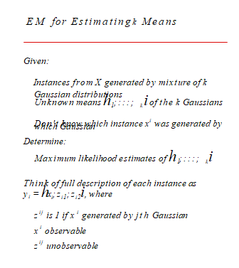

Slide 64
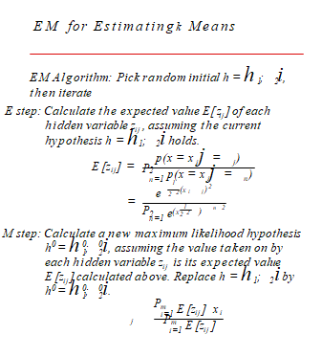

Slide 65
